Slide 1
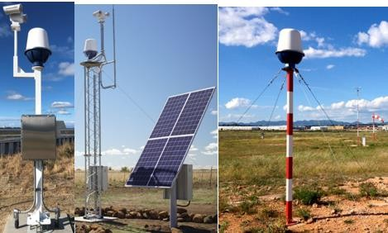
The Ground & Marine Radar Short to
Medium Range
Product Code: 6530-06
Key Features
360° Scan Every Second
5 to 2,000 metre Person Detection Range
5 to 3,000 metre Vehicle Detection Range
76-77 GHz Milimetre W Wave Band
FMCW Radar
All Weather Detection
Overview
The Ground & Marine Radar Short to Medium Range provides automatic perimeter security for large open spaces. The sensors detect moving or stationary objects appearing in all weather conditions and light levels. A range of systems that will detect people within ranges of 5 to 2,000 metres and vehicles within a range of 5 to 3,000 metres.
Features
360 Degree Scan Every Second
Automatically Detect & Track Persons & Vehicles
The systems are extremely rugged with built-in self-test, condition monitoring and calibration, they constantly scan 360 degrees once a second.
All Weather Detection
Ground & Marine Applications
The radar fills a volume of space in which detection data is processed
every 25cm from the sensor out to the instrumented range.
FMCW Radar
The radar not only detects and tracks intruders within the protected area but when integrated with CCTV surveillance systems will enable cameras to ‘lock on’ automatically to the target and track them visually on command & control screens. It can also be used for detecting debris on airport runways and motorways including stopped vehicles on smart motorways.
Range of Models
Info@awlsgh.com| www.awlsgh.com +233 302 261 190 / +233 302 236 085 10TH Estate Road. Kanda – Accra. Ghana west Africa
1

Slide 2
Ground & Marine Radar Short to
Medium Range
Applications
The Ground & Marine Radar Short to Medium Range is an ideal solution for protecting open areas from intruding persons and vehicles & boats, it can also be used for detecting debris on airport runways and motorways including stopped vehicles on smart motorways.
Key Benefits
360-degree coverage
Available for temporary or permanent installation
Battery operation optional
Built-in self-test, condition monitoring and calibration
Compact, low-cost radar surveillance
Continuous tracking of target allows intelligent assessment of intruder threat
Effective in all weather and light conditions
Enhanced site security
Ethernet interface
High range and azimuth resolution for excellent object detection
Low cost and rapid installation
Low radiated power
Solar powered options
Single unit covers up to 3km diameter
Features
They are high performance 76 - 77GHz Millimetre Wave W Band Radars designed for continuous use in harsh environments, the systems are extremely rugged with built-in self-test, condition monitoring and calibration, they constantly scan 360 degrees once a second. The radar fills a volume of space in which detection data is processed every 25cm from the sensor out to the instrumented range.
They are based on extremely accurate, reliable and easily deployable FMCW ground surveillance radar technology, driven
by a highly advanced and feature-rich software processing engine.
They deliver continuous automatic perimeter and wide-area surveillance in all-weather and light conditions through an interface, designed for intuitive and easy operation.
They will detect, track and identify the exact location of all moving objects (e.g. people, vehicles, vessels or wildlife) with extreme confidence and automatically alerts security personnel when unauthorised activity occurs inside and/or outside a site’s perimeter. They aid security personnel to identify, access and respond to potential security threats as quickly as possible and with extremely low false alarm rate.
The entire perimeter and internal area can be monitored from a single central control and display unit. With the addition of the CCTV interface, targets can be automatically tracked and viewed without any user interaction.
The site security system processes data from the radar, it constantly scans a full 360 degrees across the entire designated area monitoring stationary and moving targets from 5 metres up to a range of 3,000 metres from each sensor, in all weather and light conditions.
If objects are detected in the pre-programmed alarm zones, the system will command the CCTV to focus on those threats. The system is capable of detecting multiple intruders in different areas simultaneously and can be configured to trigger audible alarms or activate other security equipment. With fully automated detection capability, the system removes any possibility of human error.
Network enabled Surveillance Radar
Multiple radar systems can be networked together to provide complete coverage of expansive sites, a complete multi- sensor intruder detection system can be realised.
Info@awlsgh.com| www.awlsgh.com +233 302 261 190 / +233 302 236 085 10TH Estate Road. Kanda – Accra. Ghana west Africa

Slide 3
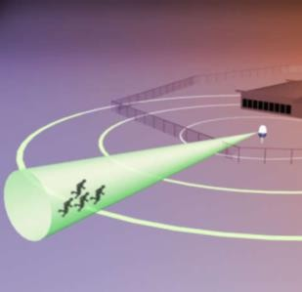
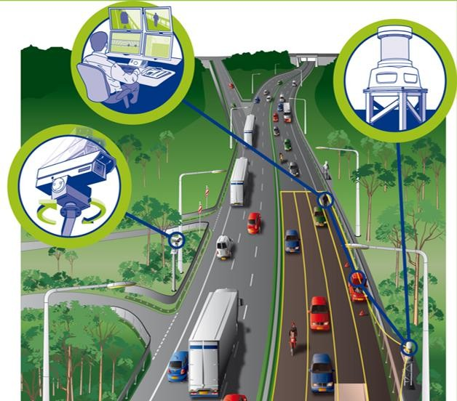
Ground & Marine Radar Short to
Medium Range
Applications
Operational Capabilities
Able to calculate heading, position and velocity of intruders and plots their track
Activates alarms or other security equipment
Assignment of detection zones, providing different levels of alarm in sensitive areas
Assignment of non-critical zones to allow for normal site operation
Automatically compensates for background changes to the environment e.g. moving trees, grass
Configurable to identify objects above a given size so that irrelevant background movements are filtered out
Continuous tracking of target allows intelligent assessment of intruder threat
Detects multiple intruders in different areas simultaneously
Detects small objects including a walking, crouching or crawling person
Directs a CCTV camera to a detected threat and automatically controls the camera to follow the threat in head/shoulders
or wide area settings
Discriminates between threats and background clutter based on heading, speed and geographical area
Effective in all light and weather conditions
Enhanced site security
Indispensable where other security systems are not practical e.g. over water
Installation is rapid and low cost and can be used for temporary or permanent applications
Manned patrols can be reduced or eliminated
Overlays a detected intruder position on a background map or aerial photograph of the area
Provides a record of movements over time across the entire survey area, or it can focus on specific areas, for example the walkways between buildings
Records AVI files and raw data sets or screen shot bitmaps
Reduced manpower costs as only one person is required to supervise operations
Selectable zones of interest to display in the field of view
Simple and easy to understand display of all detection data can be overlaid onto the site map
Very difficult to evade
Info@awlsgh.com| www.awlsgh.com +233 302 261 190 / +233 302 236 085 10TH Estate Road. Kanda – Accra. Ghana west Africa

Slide 4
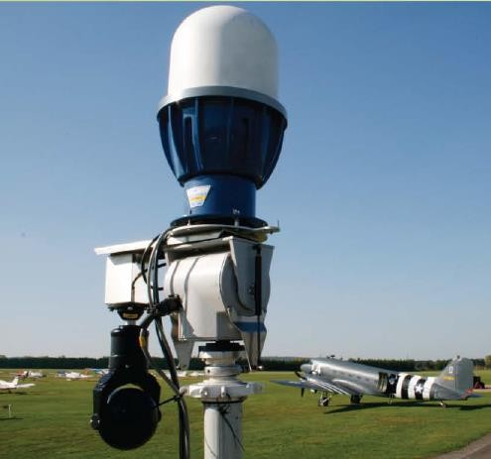
Ground & Marine Radar Short to
Medium Range
Applications
Software & Interconectability
XML API
The software supports an XML network messaging protocol which enables the system to output real time data to external systems.
This includes live target reports, alarms, camera control data and health status
The protocol also supports incoming commands to controls alarms and automatic camera control
We can provide documentation, XML Schema files (XSD) and a message simulator
Dry Relay Contacts and Digital Inputs
The software supports a device that provides dry relay contacts and digital inputs
Relays can be associated with a range of different events including alarms, camera movement and health alerts
Digital inputs can be used with static sensors such as PIR or broken beam devices, these are integrated in the software so can trigger alarms and also move cameras when activated
Digital inputs can also be used with security rules enabling specific alarms to be temporarily disabled or deactivated in response to an input. This is useful for security override from authorised users
The software supports an unlimited number of specialised units and therefore can support an unlimited number of relays
and digital inputs
3rd Party Support – Integration with the following systems
Milestone xProtect Professional 2016 or higher
Bosch VMS (BVMS)
CNL
Genetec Security Centre
Dallmeier SMAVIA VMS
Indigo Vision Control Centre VMS
Prysm Command & Control
Custom Development
Plugin / driver architecture for integration with 3rd party systems, this enables rapid development of custom integrations to support almost any system at minimal cost
Custom drivers and plugins can be added to the software without any changes to the core product
Info@awlsgh.com| www.awlsgh.com +233 302 261 190 / +233 302 236 085 10TH Estate Road. Kanda – Accra. Ghana west Africa

Slide 5
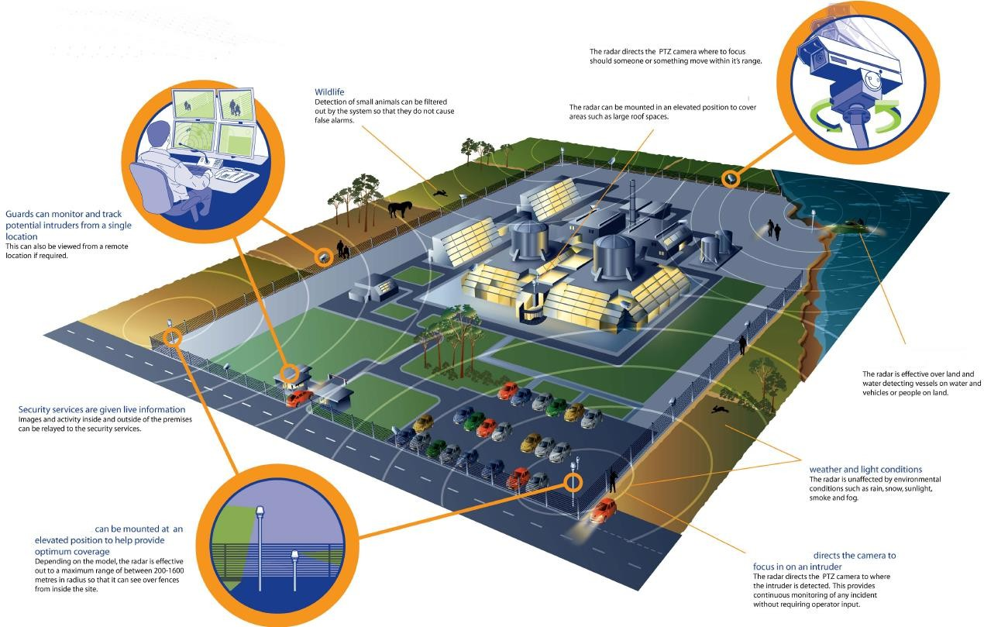
Ground & Marine Radar Short to
Medium Range
Applications
Info@awlsgh.com| www.awlsgh.com +233 302 261 190 / +233 302 236 085 10TH Estate Road. Kanda – Accra. Ghana west Africa

